Slide 1
15 Cent Airmail issues of 1959 & 1961
The differences are not always visible to the naked eye!
Mark Cooper

Slide 2
Background
Two nearly identical stamps are issued within 3 years of each other.
Despite official denials, this is clearly an attempt to correct the errors known to the U.S.P.S. with the first release.
Other forces are at play, the U.S.P.S. turns a blind eye to trends in the paper supply market place.
Unintentional consequences arise with the introduction of tagging creating collectable varieties within the scope of just two issues.

Slide 3
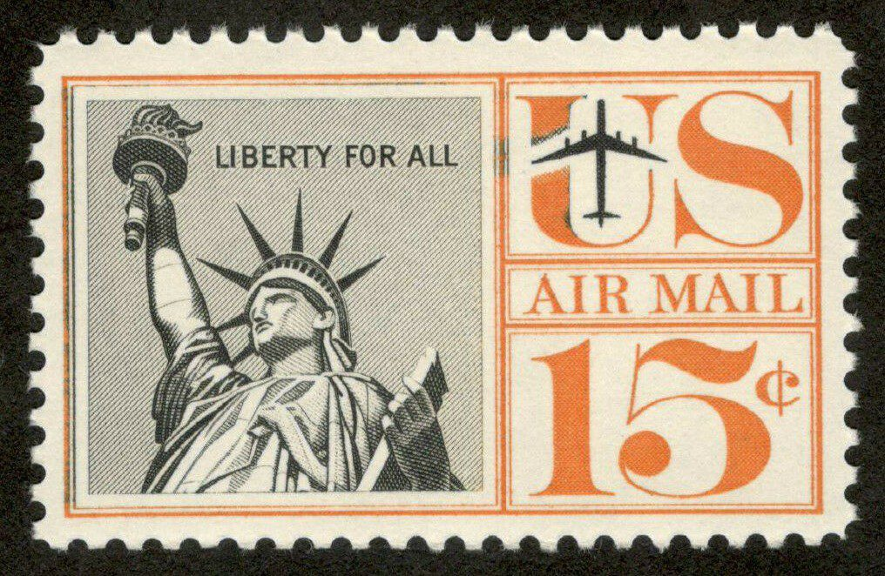
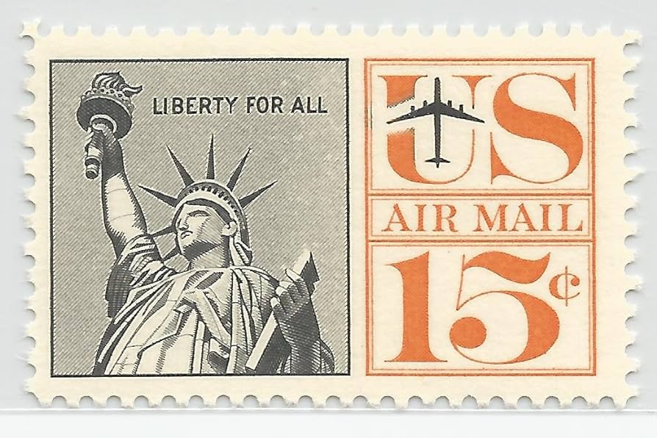
As issued!
Scott # C63 is issued on January 13th, 1961 just 410 days after the release of #C58. It too is printed on the Giori press but this time the orange frame is removed so that it mimics the other concurrent stamp issues.
Scott # C58 is issued on November 20th, 1959. Its printed using the Giori press. It is one of three designs but the only one to incorporate an orange border.
Both stamps are unwatermarked, perf 11.

Slide 4
Luminescence & Fluorescence
The USPS had witnessed other nations successfully trial, facing the mail for automated servicing using luminescent postage. It offered high speed, high volume capacity at a time of growing demand.
Never an industry leader, the U.S.P.S. trialed this new technology in Dayton, Ohio in the early 1960’s on selected issues and quickly realised it need to segregate the higher paying air mail from domestic mail for logistic reasons.
What the USPS did not fully understand was that by happenstance, it had previously used inks that react to UV light, this usage was unintentional and would go un-noticed by philatelist's until the advent of cheap portable UV lights were made available, primarily to rock hounds looking for specimens that would glow under UV.

Slide 5
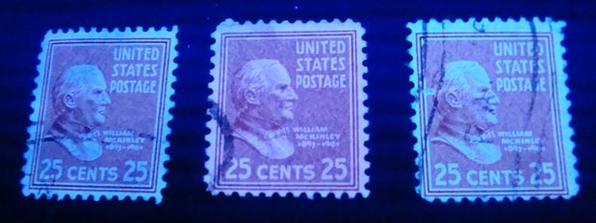
25 Cent stamps from the 1938 Presidential edition.
Stamps printed in reactive ink, as shown under shortwave UV light are relatively common. Red aniline inks in particular show this naturally occurring phenomenon commonly found on stamps issued by other nations in the same time period. This was an unintended consequence of colour specification by the U.S.P.S.
Pink ink reaction to shortwave UV

Slide 6
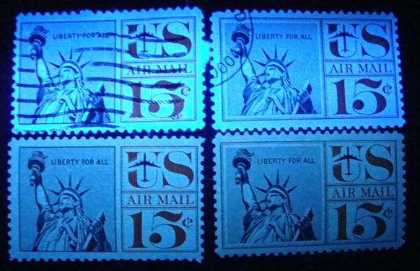
Luminescence & Fluorescence
Paper was also undergoing change to become brighter and whiter and so developments by the publishing industry, introduced a cheaper supply of paper with added optical brighteners, that also reacted to UV exposure. This optical enhancement had not been specified by the U.S.P.S. in its paper supply contracts prior to March 1964, so it can be found within the issues at random for both stamps.
Paper with optical brightener that glows violet/blue under shortwave UV light
Normal “Dead” i.e. non reflective paper (No OBA in the paper)

Slide 7
Paper Technology Advancements
Whiter paper became available to the paper industry after 1949. It originally was developed as an effective enclosure for X-Ray films as it absorbed or reflective degrading UV rays and prevented damage to the films. Another early use was in the food packaging industry. Largely introduced after 1949, it represented 70% of all paper supply by 1964.
Its use accelerated in the photographic worlds quickly and in parallel the chemical use was further developed to be used in detergents.
Known using the acronym OBA ,these whiteners sought to hide the fibers, pulp or rag that are always present in paper. US Paper money never uses these agents, so fluorescence is a useful detection of counterfeits still used today.

Slide 8
U.S.P.S. & “Hi Bright” paper usage
In March of 1964 The B.E.P. added specifications of optical brightness to paper supply contracts so as to ensure that the deployment of luminescent postage would be a success. These amended contract specifications limited the amount of optical brighteners so as to eliminate the “Hi Bright” papers that were in the commercial marketplace but allowed a certain level of brightness that over time would be further restricted in subsequent contracts.
The U.S.P.S. ran luminescent trials starting in 1963 on selected domestic & 8 cent airmail issues and had mandated the use of luminescence on all issues by January 1966.

Slide 9
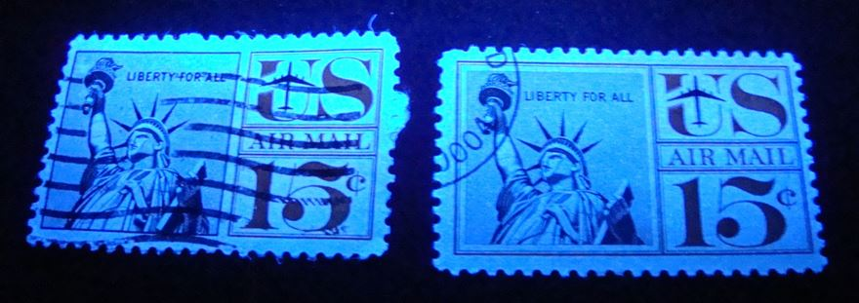
Stamp Diversity Scott # C58
Besides the design detail difference, Scott # C58 has only the optical paper variation. No know errors have been thus reported. Current catalog values do not differentiate between papers although the scarcity of optically enhanced paper varieties is recognised by collectors.
C58 & C63 both printed on optically brightened paper as issued. Blue-violet glow is evident.

Slide 10
Luminescence & Fluorescence
During the adoption of tagging onto stamps (Specifically C63) many variations can be found. Further experimentation by the U.S.P.S. reduced the amount of tagging needed to trip the sorting equipment due to cost reasons and so the major tagged varieties include:
Fully tagged, bright reaction under shortwave UV, solid colour.
Reduced tagging printed in bands clearly visible on all aspects of the design, solid colour but weaker in terms of reaction.
Mottled tagging clearly visible on some elements of the design field. This has less than 100% colour under UV light.
Reduced tagging, visible only on the inked areas both Orange and black but not appearing on the unprinted areas of the design. This technique would be fully exploited by the U.S.P.S. in the 1980’s.

Slide 11
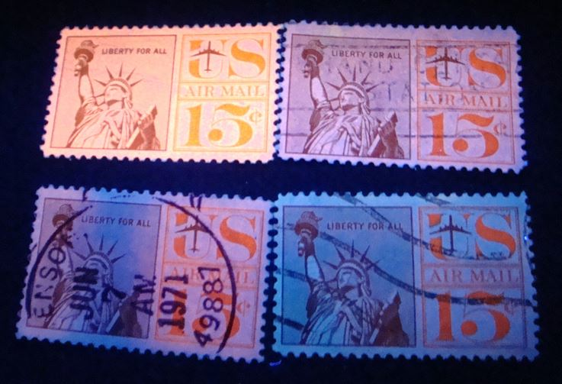
C63a variations under short wave UV light
Fully tagged, strong fluorescence under UV.
Reduced tagging, lacks the intensity of the original issue.
Mottled tagging in bands, weak colour under UV.
Weak tagging that only shows on the inked design.

Slide 12
Stamp Diversity - Scott # C63a
Scott lists the tagged variety of C63 as “C63a” as being issued on January 11th, 1967, the same year that the stamps ceased production.
The Scott values for the regular and tagged editions are virtually identical. This is in sharp contrast to the values for the printing or cutting errors for which the U.S.P.S. is famous.
This similarity in values between the C63 and the C63a does not make sense given the relatively short time the tagged version was in production and the variations that can be found using a short wave UV lamp, besides the differences in the paper used. Thus catalogue values are biased towards those that can be detected with just the naked eye.

Slide 13
Thank you!
Mark Cooper
KPS Webmaster
January 2024.

